Slide 1

A REVIEW OF THE TOOLS AND TECHNIQUES FOR SOFTWARE RISK ANALYSIS
System Development Technology EMoS 6308
Ochira Batulumeo M081/SSD21
Innocent Kitauka M040/T21
Japheth Abashe M093/NG21
Jacinta Babu M085/KE21

Slide 2
What Is Software Risk?
Risk is an expectation of loss, a potential problem that may or may not occur in the future.
It is generally caused due to lack of information, control or time.
A possibility of suffering from loss in software development process is called a software risk.
Loss can be anything, increase in production cost, development of poor quality software, not being able to complete the project on time.

Slide 3
Why is Risk Management Important
The only alternative to risk management is crisis management --- and crisis management is much more expensive, time consuming and embarrassing.
JAMES LAM, Enterprise Risk Management, Wiley Finance © 2003
Risk management means more than preparing for the worst; it also means taking advantage of opportunities to improve services or lower costs.
Sheila Fraser, Auditor General of Canada

Slide 4

Risk Management Basics
Risk (uncertainty) may affect the achievement of objectives.
Effective mitigation strategies and controls can reduce negative risks (threats) or increase opportunities.
Residual risk is the level of risk remaining after applying risk controls.
Acceptance and action should be based on residual risk levels.

Slide 5
Risk Categorization
Project Schedule and Scope Risks
They threaten the project plan
If they become real, it is likely that the project schedule will slip and that costs will increase
Technical risks
They threaten the quality and timeliness of the software to be produced
If they become real, implementation may become difficult or impossible
Business risks
They threaten the viability of the software to be built
If they become real, they jeopardize the project or the product
Financial risks
Personnel risks

Slide 6
Steps for Risk Management

Slide 7
Steps for Risk Management
Risk Management Planning
Risk Identification
Qualitative Risk Analysis
Quantitative Risk Analysis
Risk Response Planning
Risk Monitoring and Control

Slide 8
Steps for Risk Management
Risk Management Planning
- deliverable is the Risk Management Plan
Risk Identification
Risk categories:
- technical
project management
Organizational
external

Slide 9
Steps for Risk Management
Qualitative Risk Analysis
- define probability and consequences
- data gathering
- impact by objective
- assumptions testing
- data precision ranking
Quantitative Risk Analysis
- individual and project risk
- probability distributions
- sensitivity and decision tree analysis
- simulation methods

Slide 10
Steps for Risk Management
Risk Response Planning
Responses should be:
- appropriate
- cost-effective
- timely, realistic
agreed (funded)
Risk Monitoring and Control
- ongoing, continuous action
risks monitored
new risks identified
effectiveness of risk management evaluated

Slide 11
Available Tools and Techniques
Tool | Developer | Where it can be used | Which analysis techniques are used | Which RM activities are supported
Risk Radar | Software Program Managers Network | Risk identification and prioritisation | Risk rating | Risk identification and monitoring
@Risk | Palisade Europe | Project cost/schedule risk estimation | Monte Carlo Simulation | Risk analysis
ACE/RI$K | ACEIT | Cost/schedule risk analysis and technical risk assessment | Latin Hypercube sampling | Risk analysis
CRIMS | Expert choice | Comparison of alternatives according to preset criteria | Analytical Hierarchy Process | Risk analysis
REMIS | HVR Consulting Services | Structured support for all risk management phases, integrated with other support tools (e.g., @Risk), construction of WBS, risk register, mitigation plans | Monte Carlo simulation | Risk identification, analysis, response and monitoring

Slide 12
Criticisms and pitfalls
Simplistic risk assessment techniques
Inadequate risk definition
Lack of integration
The ambiguity of risk management expectations

Slide 13
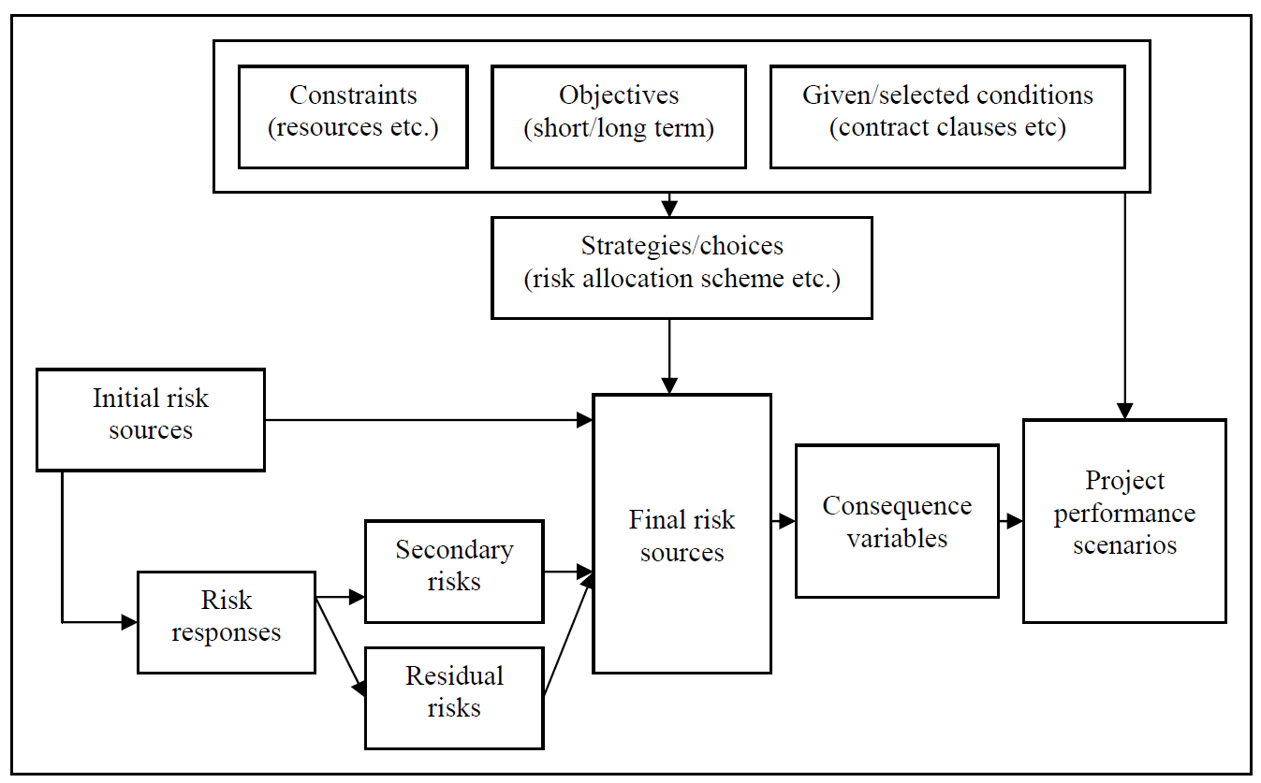
Future Works

Slide 14
Future Works
Module 1: Defines Risk Breakdown Structure (RBS), Work Breakdown Structure (WBS), Project Organization Structure (POS), and Activities (schedule)
Module 2: Defines the interdependence of risks, project objectives, activities, strategies/responses and ownership.
Module 3: Development of a project performance model (integration of objectives like time, cost and quality)
Module 4: Scenario creation by changing the values of predefined variables (objectives, responses, ownership, constraints and risk of scenarios) and simulation of project performance under various scenarios.
Module 5: Building a corporate risk/response memory

Slide 15
Conclusion
our comparative analysis concludes that no single tool or technique, on its own, is perfect for managing risks in software development.
As a result, we believe that our comparative analysis will assist and provide basic ideas to institutions in the shortlisting of risk management techniques based on their developments.

